Slide 1
Think Babies™ Advocacy Training (Presenter name)
(Date)

Slide 2
Agenda (Sample- modify as needed)
Welcome and Overview
Introductions
Think Babies Advocacy Presentation
Overview of Think Babies and why we must make the potential of every baby our national priority
Infant-toddler policy priorities
Learning about the policymaking process
Your voice matters!
Advocacy actions you can take to move the needle for babies
Time to Practice
Commitments
Reflections and Closing

Slide 3
Introductions
(consider a prompt to help connect participants to the reasons they want policymakers to Think Babies, such as “what does it mean to you to be an advocate on behalf of infants, toddlers and families?”)

Slide 4
What is Think Babies™ ?
ZERO TO THREE created the Think Babies™ campaign to bring nationwide attention to what babies and families need to thrive.
Notes:
The greatest opportunity to influence a child’s life outcomes—academic, social and emotional, and physical—begins early, even before birth. Investing in giving all babies the best chance to succeed in life will build a better future for all of us. This is why ZERO TO THREE created the Think Babies campaign to bring nationwide attention to what babies and families need to thrive.
Consider showing Think Babies video: https://www.youtube.com/watch?v=H2bwqLZPwYk&t=3s]

Slide 5
The Science Behind Think Babies™
Babies’ brains form more than a million new neural connections every second.
The impact of babies’ early experiences lasts a lifetime.
Notes:
The science is clear – our brains grow faster between the ages of 0 and 3 than at any later point in our lives. When we Think Babies and invest in infants, toddlers, and their families, we ensure a strong future for us all.
When babies have nurturing relationships, early learning experiences, and good nutrition, those neural connections are stimulated and strengthened, laying a strong foundation for the rest of their lives.
When babies don’t get what their growing brains need to thrive, they don’t develop as they should. This leads to life-long developmental, educational, social, and health challenges.

Slide 6
Our Priorities
Good Health
Strong Families
Positive Early
Learning Experiences
Notes:
We advocate for policies that ensure babies and their families have what they need to thrive, including:
Good health;
Strong families;
Positive early learning experiences

Slide 7
Think Babies™ Policy Solutions
Access to affordable, quality child care for infants and toddlers
Time for parents to bond with their babies through paid leave
Access to Early Head Start
Access to voluntary, evidenced-based home visiting
Access to infant and early childhood mental health services
Access to child and family screenings, supports, and linkages to needed services
Support for family economic security
Access to quality, affordable health care
Access to nutrition services
Notes:
In order to achieve those priorities, Think Babies supports a variety of policy solutions that are being advanced both through the national campaign and by state and local partners across the country. These include:
Access to affordable, high quality child care for infants and toddlers that supports their healthy development and meets the needs of parents;
Time for parents to bond with their babies through paid leave when we know so much of their development is at stake;
Access to Early Head Start which through a two-generation approach, creates opportunities for both parents and children, helping parents improve their prospects for economic security while simultaneously ensuring their children are on a solid path from the earliest age to engage in lifelong learning.
Access to voluntary, evidence-based home visiting which is a proven strategy to support parents in nurturing their children.
Access to Infant and early childhood mental health (IECMH) services because we know that healthy social and emotional development is the foundation of all future learning and development.
Access to child and family screenings, supports, and linkages to needed services because the better able we are to connect and provide parents with support, resources, and guidance, the greater the positive impact on children.
Support for family economic security because we realize that young children grow and learn in the context of their families and communities. Ensuring family and community level economic security is fundamental to creating the environment in which young children thrive.
Access to quality, affordable health care so that infants and toddlers can receive the critical services and treatment they need to build a strong foundation for their futures. And
Access to nutrition services to ensure infants, toddlers, and pregnant people receive nutritious food, which is so important during this time period of rapid growth and development.
Note: This list isn’t meant to imply that everyone is working on every policy solution. The context and priorities of states vary and the context between state and national work can be really different.

Slide 8
Think Babies™ Campaign Strategies
Raise awareness of early brain development through advocacy and communications activities.
Strengthen advocacy capacity to advance infant-toddler policy priorities.
Leverage increased policymaker and public awareness and will to advance the infant-toddler policy priorities.
Notes:
The Think Babies campaign is a multi-pronged approach that includes the following strategies:
Engaging in advocacy and communications activities to raise awareness of early brain development and why it is so critical that children get the supports they need in first years of life.
Working with ally organizations at state and national levels to increase advocacy capacity to advance infant-toddler policy priorities.
Leveraging the increased policy maker and public awareness and will to advance infant toddler policy priorities.

Slide 9
[Local Policy Context]
[Provide info about your state/local policy context and priorities]
[placeholder]
[placeholder]
[placeholder]
Notes:
(Keep in mind that this training is non-lobbying, we suggest reviewing the lobbying guidance included in the toolkit. )

Slide 10
Your Voice Matters!
YOU are an expert on what infants, toddlers and families in your community need to thrive
Policymakers want to hear from constituents- they work for you!
Stories are POWERFUL

Slide 11
Ways You Can Take Action
Meet with policymakers
Call or write to policymakers
Letters to the Editor and Op-eds
Spread the word within your networks
Site visits with policymakers
Attend policymaker townhall events

Slide 12
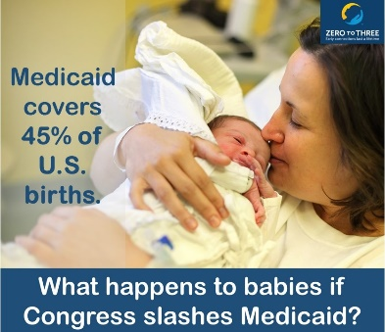
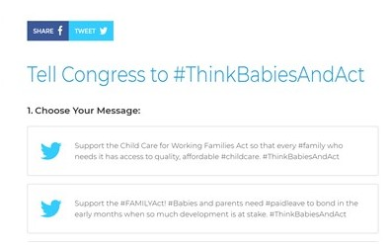
Tools for Use
Notes:
There are many tools available on the ZERO TO THREE website, including tools for advocacy, graphics and infographics to use on social, written resources for advocates and elected officials, and how-to’s.
There’s a bunch of stuff on the Think Babies site, including a tell Congress tool, that allows you to Tweet messages directly at your Members of Congress, a toolkit, and an opportunity to tell your story for use in advocacy efforts.

Slide 13
More Information
Visit www.thinkbabies.org
Sign up to receive Think Babies™ campaign updates and action alerts from ZERO TO THREE
Visit https://www.zerotothree.org/policy-and-advocacy
(insert info about your organization)
© 2018 Trister, Ross, Schadler & Gold, PLLC

Slide 14
Questions so far?

Slide 15
Time to Practice
(this could include having participants work on developing their own stories, role playing, shooting a short video for social media, etc. Consider using Telling Your Story Worksheet)

Slide 16
Think Babies Pledge
Pledge to join the team that’s fighting for our future:
https://www.thinkbabies.org/take-action-pledge-to-think-babies/
Take a couple of minutes right now to commit to taking the next step in your advocacy.
Notes:
The Pledge signs them up to receive Think Babies updates about future opportunities for advocacy and gives three easy options for for them to take action now including:
Offer to be a resource to your Members of Congress on issues that impact their youngest constituents and their families.
Tell Congress about what babies and families need to thrive.
Ask your network to join you by sharing the Think Babies pledge using the Facebook and Twitter buttons in the upper left.

Slide 17
Closing Reflections

